Slide 1

Data-Driven Attitude Modeling and Control of Quadrotor UAV’s using Koopman Operator
22AIE448 Introduction to Drones
Team CD-14:
1. Arepalle Charan Kumar Reddy (207)
2. Polturi Aditya Pavan (344)
3. Koushik V (330)
4. Rohit kanna S (349)
5. Mahendrada Shalini (334)

Slide 2
PROBLem statement
Quadrotor attitude dynamics are nonlinear and strongly coupled, making accurate modeling difficult.
Model-based approaches require simplifying assumptions that can reduce the accuracy of the real-system model.
Data-driven approaches require suitable training data and may result in black-box models, while ensuring system stability remains challenging.
Linear control approaches may neglect important system dynamics, while MPC can involve high online computational cost.
Therefore, an accurate, data-driven, computationally efficient, and control-oriented representation of nonlinear quadrotor attitude dynamics is required.

Slide 3
Objectives
Develop a data-driven attitude model for quadrotor UAVs using Koopman operator theory.
Transform the nonlinear attitude dynamics into a high-dimensional linear model.
Design an LQR controller for stable and accurate attitude tracking.
Validate the model’s prediction capability using measured quadrotor data.
Evaluate the control performance against a PID controller.
Model the nonlinear attitude dynamics from data and use the resulting linear representation for effective and stable attitude control.

Slide 4
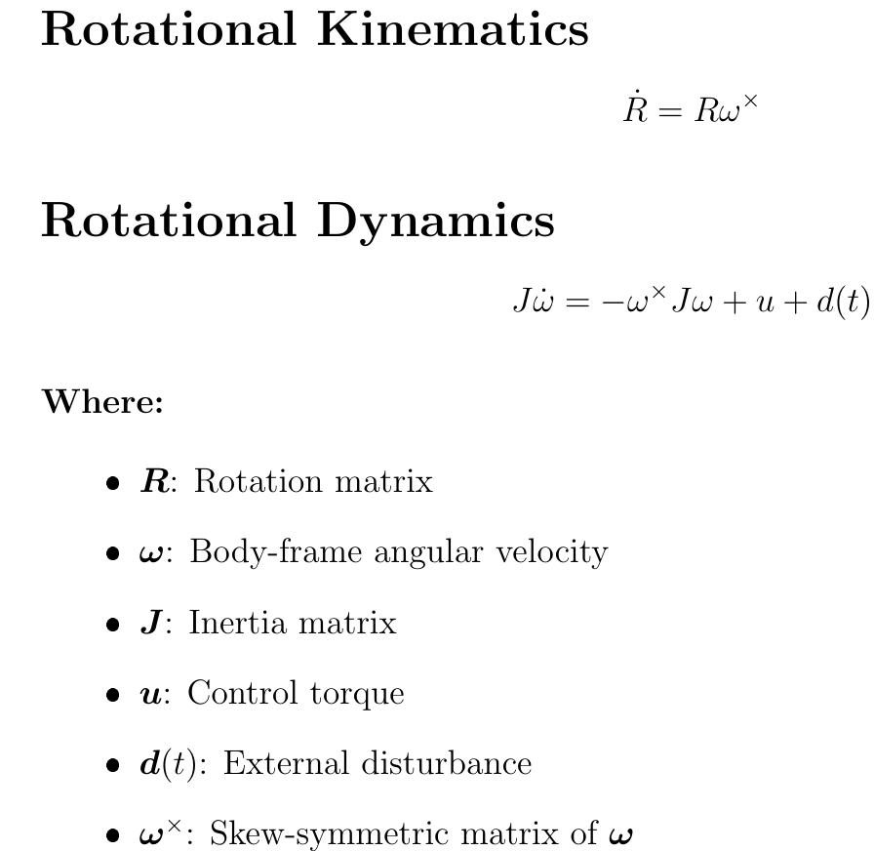
Methodology
1. Formulation of Nonlinear Quadrotor Attitude Dynamics (Newton Euler Method)

Slide 5
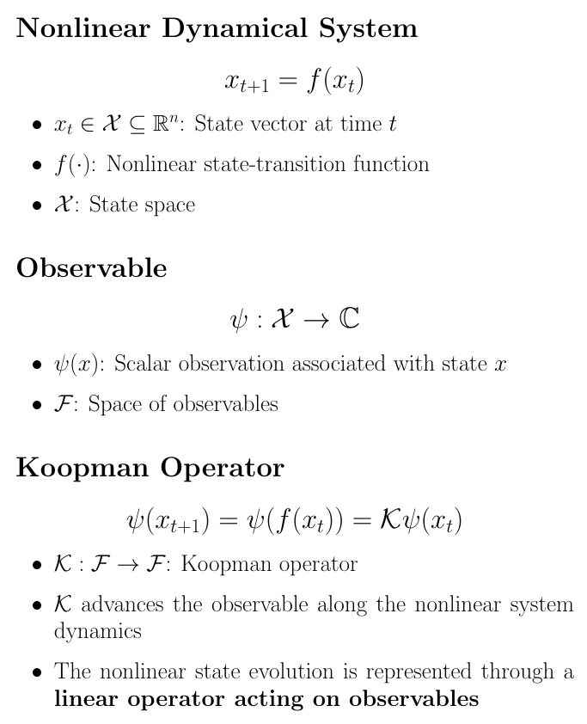
2. Nonlinear Attitude Dynamics and Koopman Representation

Slide 6
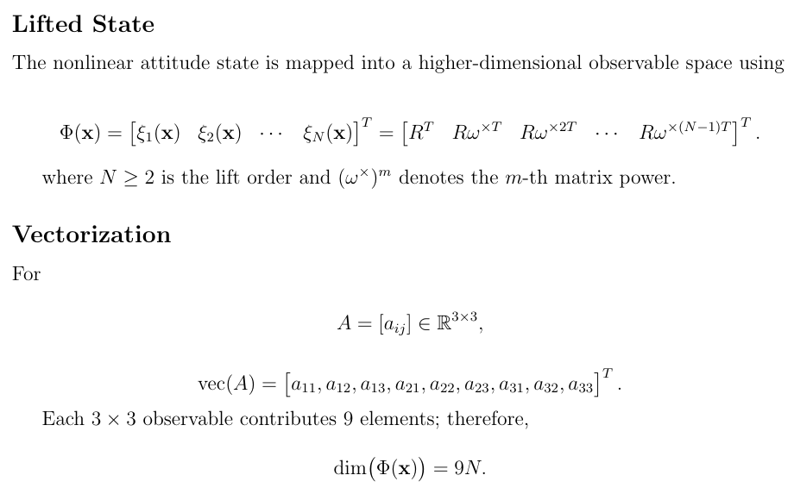
3. Koopman Lift Map and Vectorization

Slide 7
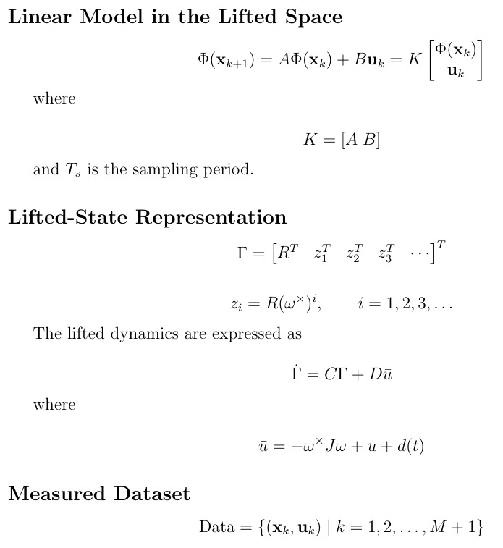
4. Finite-Dimensional Koopman Model and Data Collection

Slide 8
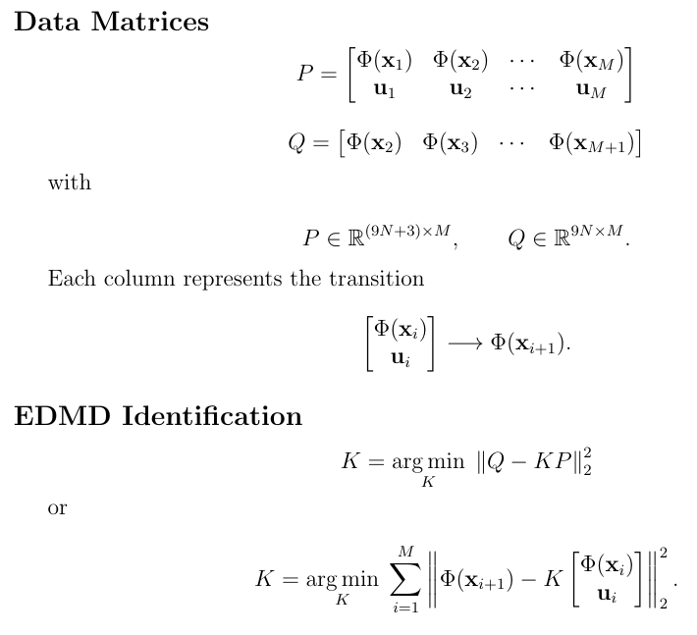
5. EDMD Data Matrices and Least-Squares Identification

Slide 9
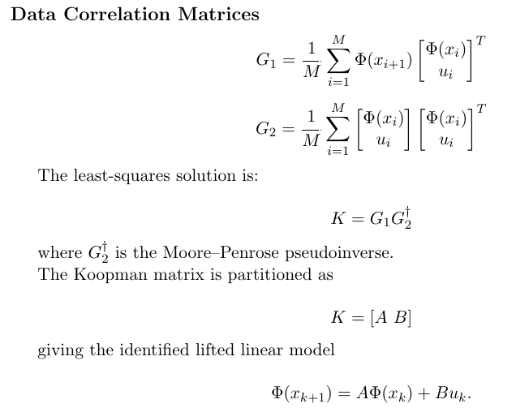
6. Koopman Matrix Estimation

Slide 10
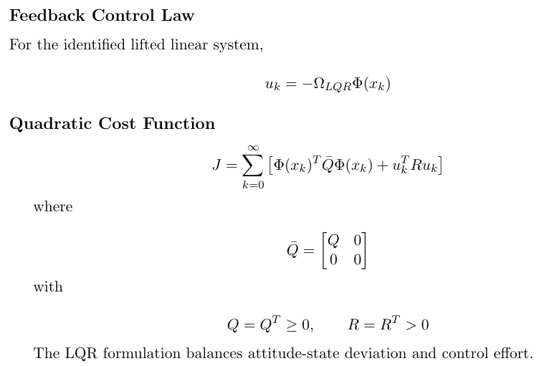
7. Koopman-Based LQR Controller

Slide 11
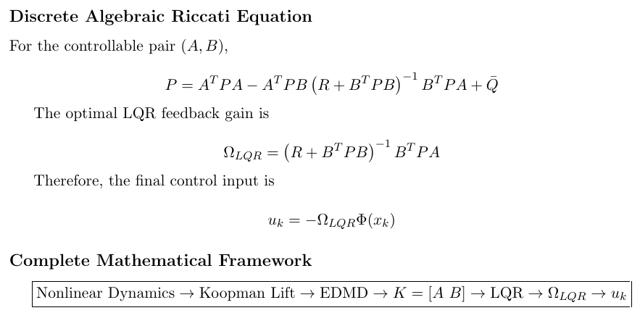
8. Riccati Equation and Optimal Control Gain

Slide 12
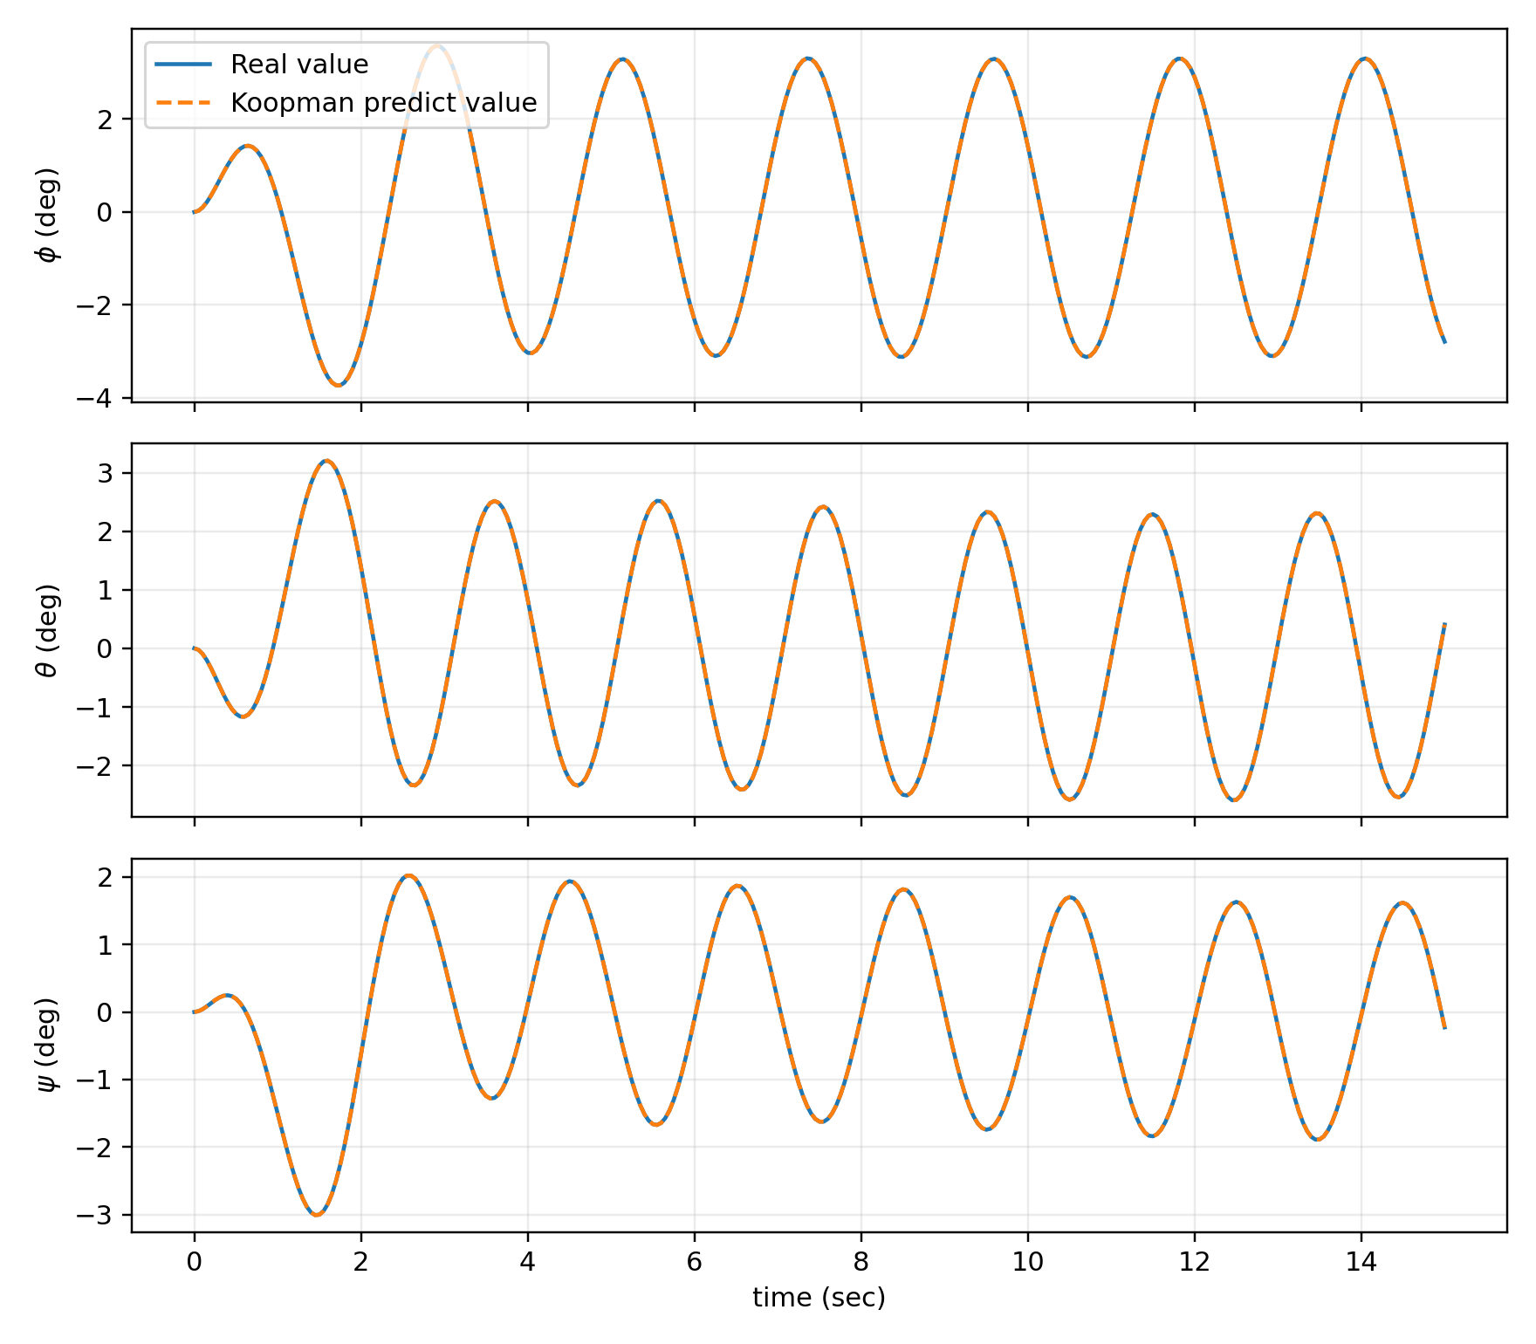
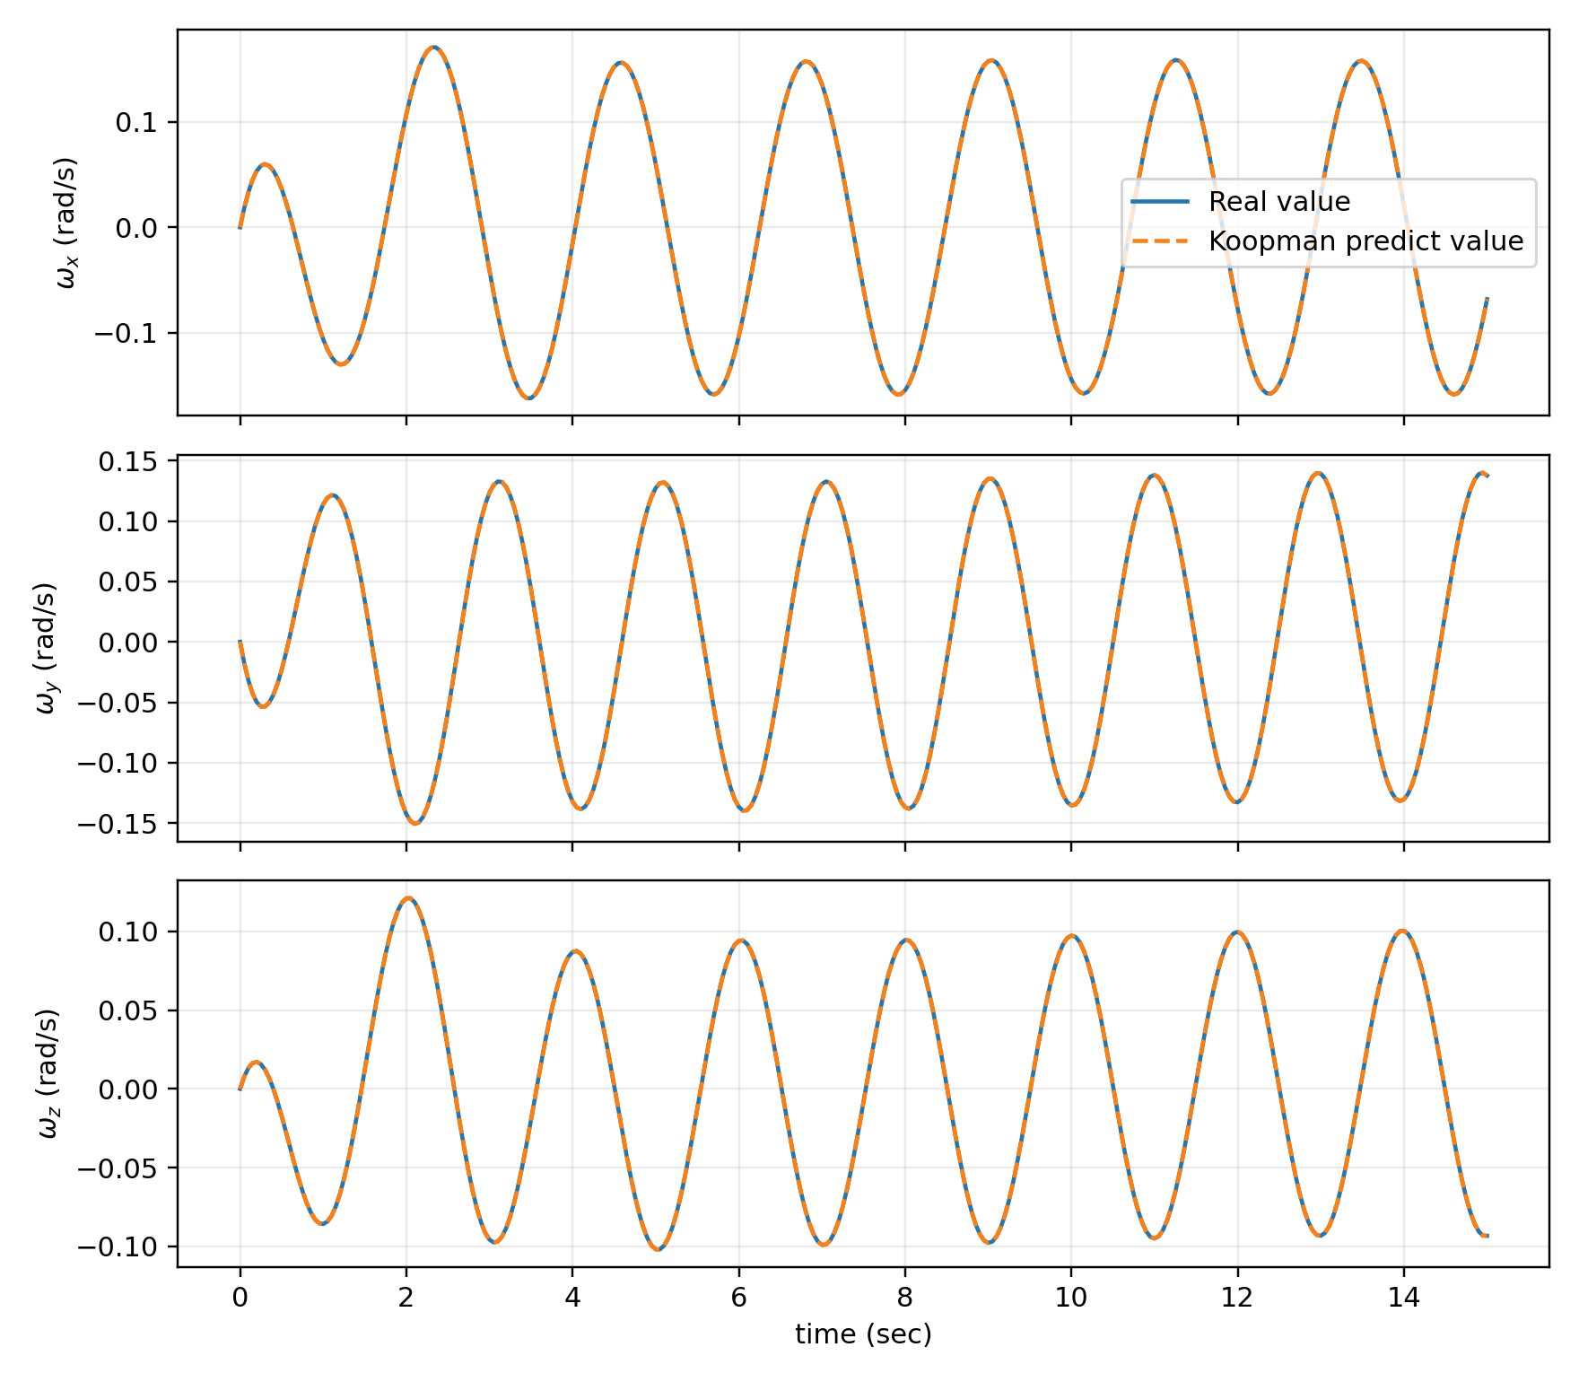
Results
Attitude prediction under the koopman model
Attitude velocity prediction under the koopman model

Slide 13
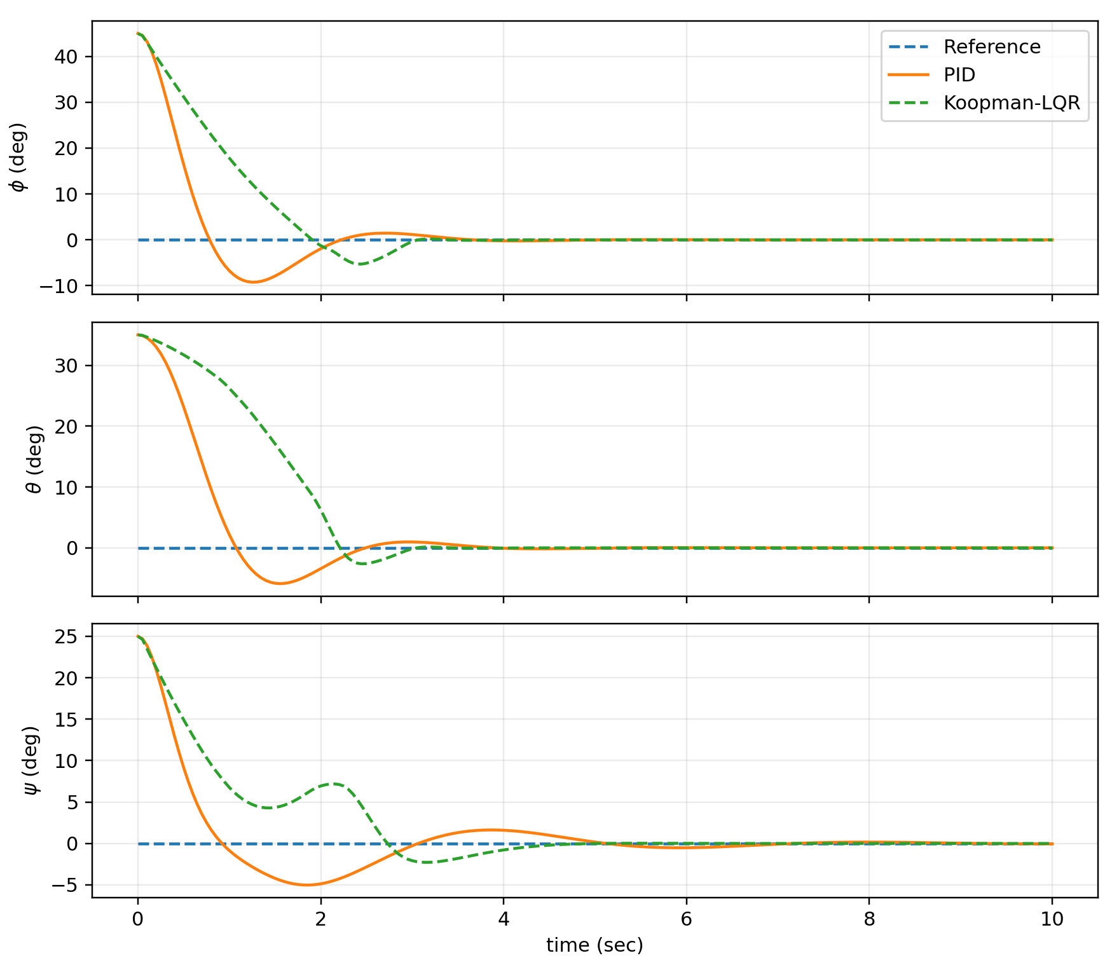
Attitude prediction under PID controller and Koopman LQR controller

Slide 14
Thank you

